Slide 1
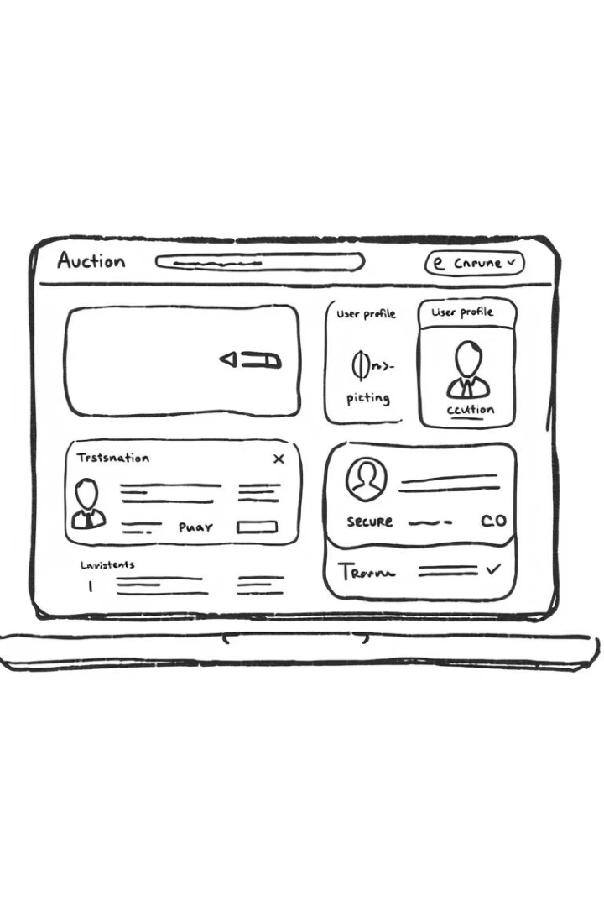
PrimeBid: An Online Bidding System
PrimeBid is a web-based auction platform designed to provide a transparent, secure, and user-friendly experience for both sellers and buyers. Built using Node.js, React.js, and MongoDB, PrimeBid aims to simplify the auction process with real-time bidding and role-based access.
This project report outlines the development of PrimeBid, detailing the existing system, proposed enhancements, system requirements, and testing strategies employed to ensure its functionality and reliability.
Presented by : Umesh Mali

Slide 2
Existing System and the Need for PrimeBid
Existing Systems
The Need for PrimeBid
Traditional auction systems often involve complex procedures and high fees. Platforms like eBay can be overwhelming for new users and may not suit localized sellers.
PrimeBid fills the gap by offering a dedicated, lightweight, and straightforward auction platform. It provides direct seller-to-buyer auctioning with real-time bidding and simplicity.
Many users prefer minimal interfaces with essential features and enhanced security. PrimeBid is tailored for those seeking a secure, time-bound, and transparent digital environment for listing or buying items.

Slide 3





PrimeBid's Key Objectives
Secure Platform
Create a secure online platform for time-bound auctions.
Multiple User Roles
Support Super Admin, Seller, and Bidder roles.
Auction Management
Enable sellers to create and manage auction listings.
Real-Time Bidding
Allow bidders to place bids with live feedback.
PrimeBid aims to simplify the payment proof upload and verification process, providing a full-featured Admin Dashboard for platform monitoring and management.

Slide 4
System Requirements and Technology Stack
Hardware Requirements
Software Requirements
Processor: Intel i5 or higher
Frontend: ReactJS
RAM: Minimum 8 GB
Backend: Node.js + Express.js
Hard Disk: At least 100 GB free space
Database: MongoDB (NoSQL)
Network: Reliable internet connection
Code Editor: Visual Studio Code
The system was developed and tested on both Windows 10 and macOS, ensuring platform independence. MongoDB was chosen for its flexible schema design, ideal for storing auction, bid, and user data.

Slide 5

Feasibility Study
Technical Feasibility
Operational Feasibility
PrimeBid uses widely supported technologies like ReactJS, Node.js, and MongoDB, all open-source and suitable for scalable applications.
The system is designed with clear user roles and intuitive workflows, making it easy for sellers to list products and buyers to bid in real-time.
Economic Feasibility
All tech used is open-source, removing licensing costs. Hosting costs are minimal, making it viable even for individual use or small startups.
The system is platform-independent and works smoothly on any modern web browser, ensuring broad accessibility.

Slide 6
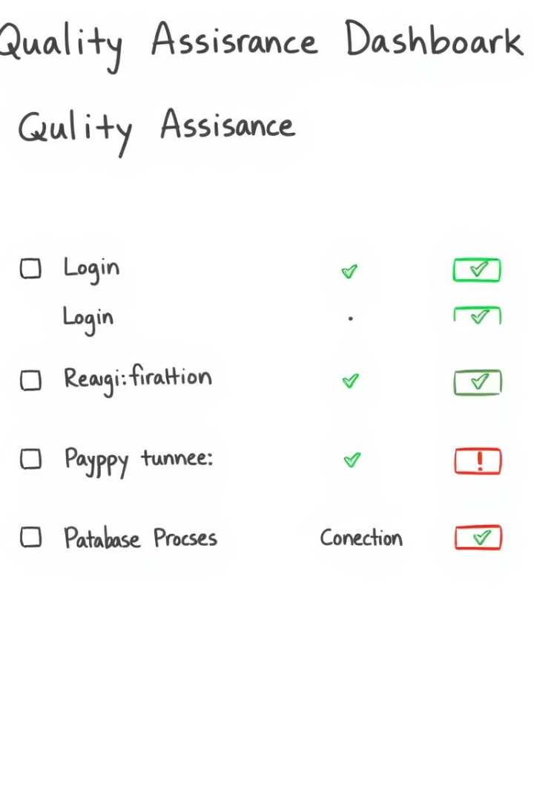




Testing Strategy and Defect Report
Unit Testing
Testing individual functions like login and bid placement.
Integration Testing
Ensuring smooth communication between frontend, backend, and database.
System Testing
Verifying the entire platform works as expected.
Security Testing
Ensuring proper authentication and data protection.
The test strategy focuses on ensuring functionality, security, and stability using both manual and automated testing approaches. No defects were encountered in the current test cases.

Slide 7
Limitations and Proposed Enhancements
Limitations
Proposed Enhancements
Website downtime and slow page loads can disrupt auctions.
Implement AI for personalized recommendations and fraud detection.
Users in different time zones may face engagement difficulties.
Use blockchain for transparent and secure transactions.
Auction websites can be vulnerable to hacking and fraud.
Enable AR for visualizing products in 3D.
Further enhancements include improved mobile experience, global expansion with multilingual support, and regional payment gateways.

Slide 8

Conclusion
PrimeBid successfully integrates modern web technologies to deliver a seamless and real-time bidding experience. The project showcases effective use of the MERN stack and Socket.IO for real-time updates and role-based access control.
From designing a clean frontend to building a robust backend API, this project provided a comprehensive full-stack development experience. PrimeBid is a scalable and production-ready application that reflects technical proficiency and a strong understanding of user experience.

